Slide 1
Secure Data access
Microsoft Fabric

Slide 2
Introduction
Security in Microsoft Fabric is optimized for securing data for specific use cases. Different users need the ability to perform various actions in Fabric to fulfill their job responsibilities.
Fabric facilitates this by allowing you to grant users access to specific data workloads through workspace and item permissions, compute permissions, and OneLake data access roles
In this module, you'll learn how to use the Fabric access control features available to secure your data and provide your team with the necessary access within Fabric to perform their job duties. You'll explore Fabric’s multi-layer security model and how to use it to manage data access

Slide 3
Secure data by use case
Different users within your company or partner organizations need to view, transform, analyze, aggregate, and use this data to derive business insights. Users need access to different Fabric compute engines, items, and workspaces to perform their jobs effectively:
Data engineers need access to data in a lakehouse to develop downstream data products.
Business or data analysts need to query data to answer business questions.
Data scientists need to access data in a lakehouse and consume it through Apache Spark to create models and experiments.
Report creators need to build reports to share with report consumers.
Report consumers need to view data in Power BI reports to make decisions.

Slide 4
Security level
Fabric has three security levels and they're evaluated sequentially to determine whether a user has data access. The order of evaluation for access is:
Microsoft Entra ID authentication: checks if the user can authenticate to the Azure identity and access management service, Microsoft Entra ID
Fabric access: checks if the user can access Fabric.
Data security: checks if the user can perform the action they've requested on a table or file.

Slide 5
Data security
The third level, data security, has several building blocks that can be configured individually or together to align with different access requirements. The primary access controls in Fabric are:
Workspace roles
Item permissions
Compute or granular permissions
OneLake data access controls (preview)

Slide 6
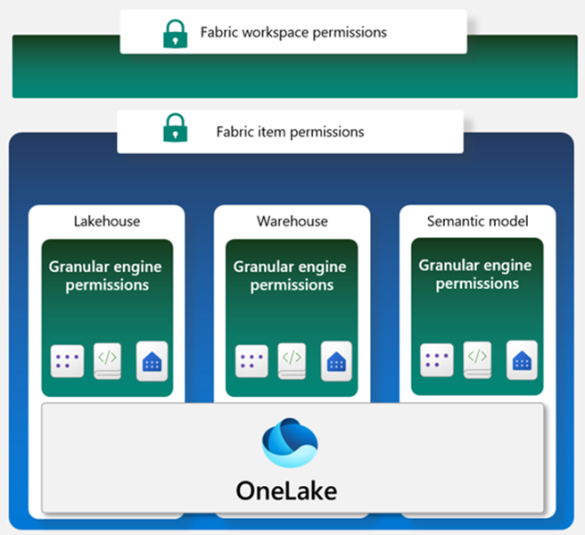

Slide 7
Security
A workspace in Fabric enables you to distribute ownership and access policies using workspace roles. Within a workspace, you can create Fabric data items like lakehouses, data warehouses, and semantic models. Item permissions can be inherited from a workspace role or set individually by sharing an item. When workspace roles provide too much access, items can be shared using item permissions to ensure proper security.
Within each data item, granular engine permissions such as Read, ReadData, or ReadAll can be applied.
Compute or granular permissions can be applied within a specific compute engine in Fabric, like the SQL Endpoint or semantic model.
Fabric data items store their data in OneLake. Access to data in the lakehouse can be restricted to specific files or folders using the role-based-access control (RBAC) feature called OneLake data access controls (preview).

Slide 8
Workspace role
Workspaces are environments where users can collaborate to create groups of items. Items are the resources you can work with in Fabric such as lakehouses, warehouses, and reports. Workspace roles are preconfigured sets of permissions that let you manage what users can do and access in a Fabric workspace.
Item permissions control access to individual Fabric items within a workspace. Item permissions let you either adjust the permissions set by a workspace role or give a user access to one or more items within a workspace without adding the user to a workspace role.

Slide 9
Workspace role
Let's consider some scenarios where you would need to configure data access using workspace roles and item permissions.
Suppose you work at a health care company as the Fabric security admin. You need to set up access for a new data engineer. The data engineer needs the ability to:
Create Fabric items in an existing workspace
Read all data in an existing lakehouse that's in the same workspace where they can create Fabric items
Workspace roles control what users can do and access within a Fabric workspace. There are four workspace roles and they apply to all
items within a workspace.

Slide 10
Workspace role
Workspace roles can be assigned to individuals, security groups, Microsoft 365 groups, and distribution lists.
Users can be assigned to the following roles:
Admin - Can view, modify, share, and manage all content and data in the workspace, and manage permissions.
Member - Can view, modify, and share all content and data in the workspace.
Contributor - Can view and modify all content and data in the workspace.
Viewer - Can view all content and data in the workspace, but can't modify it.

